Slide 1

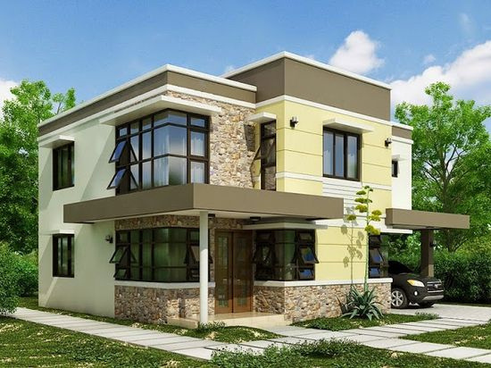

REAL ESTATE BOOKING WEBSITE
Presented by: Yash Verma
Roll Number: 2110991581
Group: G7

Slide 2

Overview
Problem Statement
What is Real-estate
Features of Website
Technologies used
Flowchart
Working
Home Page
Add property page
future scope

Slide 3


Problem Statement
Current Real Estate Booking websites lack user-friendly interfaces, struggle to provide comprehensive property information, and lack efficient communication tools between buyers and sellers. There's a need for a platform that simplifies property search, improves data quality, and streamlines communication for a better user experience.

Slide 4
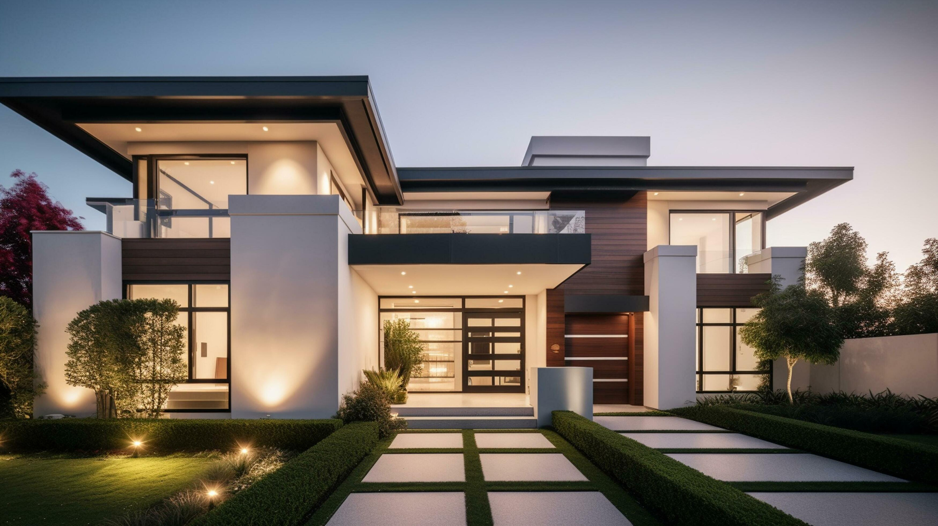
What is Real-Estate
Real Estate refers to property consisting of land, buildings, natural resources, and other improvements on the land. It encompasses residential, commercial, and industrial properties. Real estate can be bought, sold, rented, or leased, and it's often considered an investment because property values can appreciate over time.

Slide 5

Features of Real-Estate Website

Slide 6






Language Used
Backend Connectivity
HTML
NodeJs
CSS
Express Js
JavaScript
Database
React
Mongodb

Slide 7
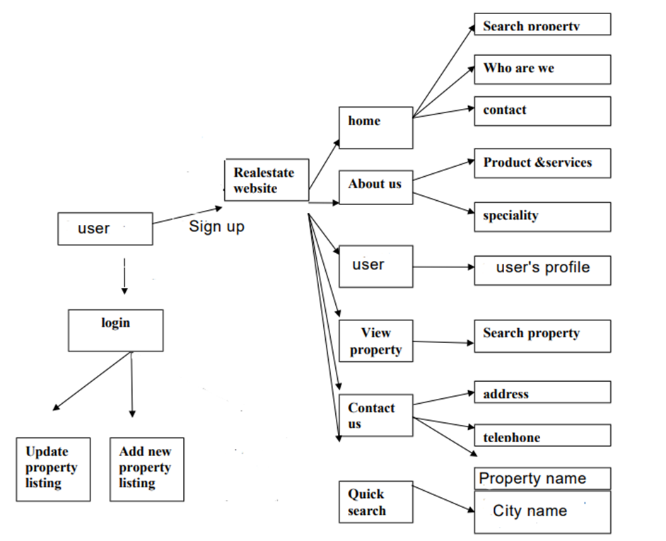


Flowchart

Slide 8


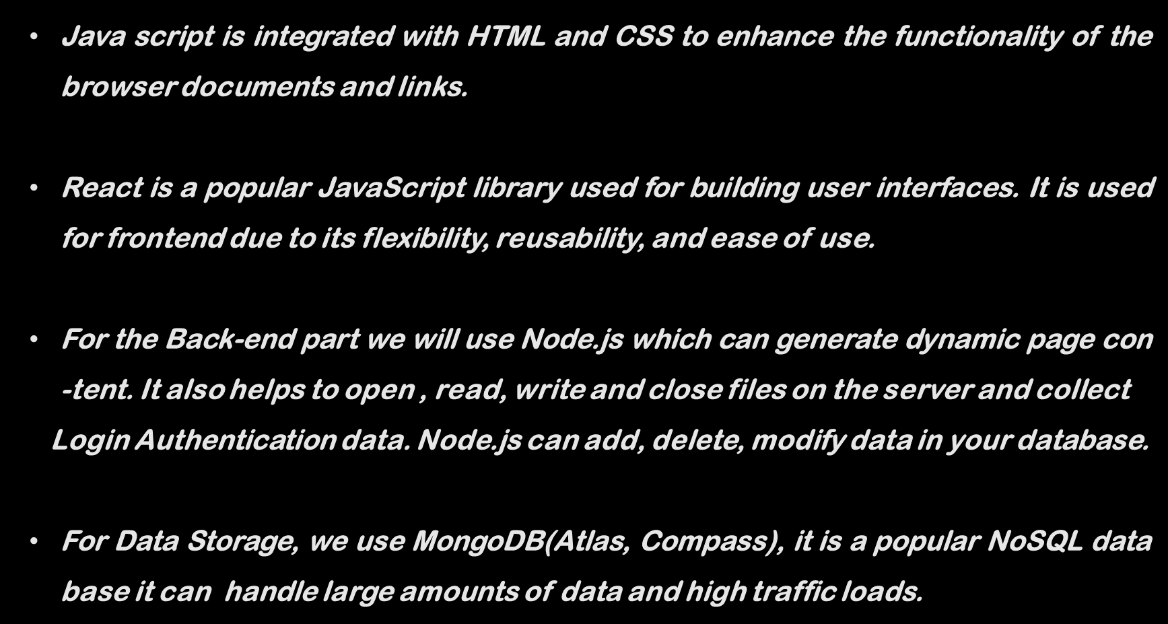
Working

Slide 9
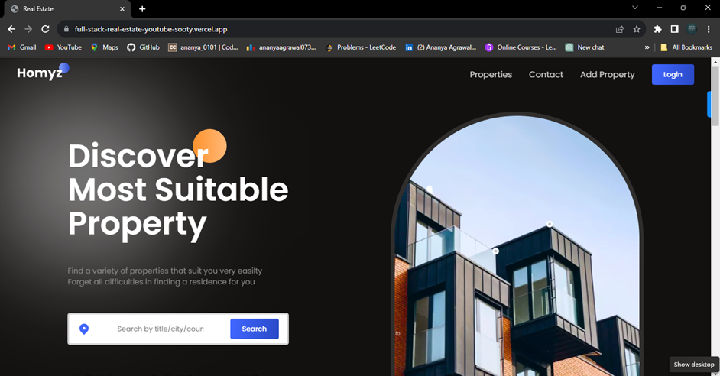
Home Page

Slide 10
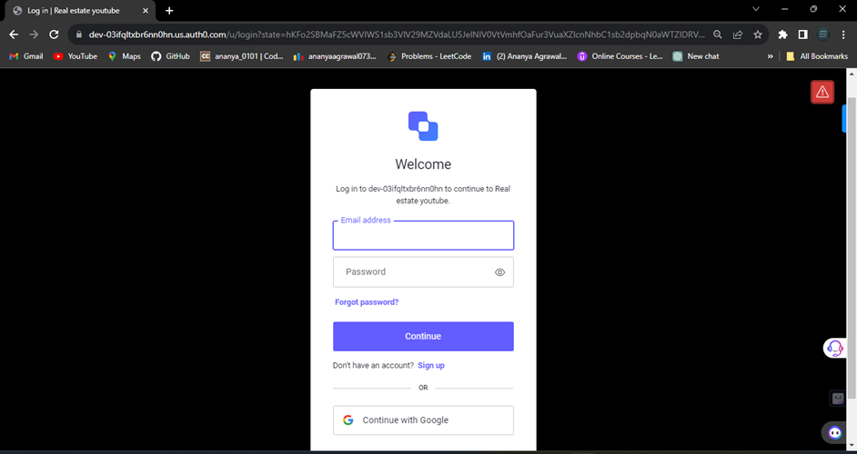
Login and Sign up Page

Slide 11
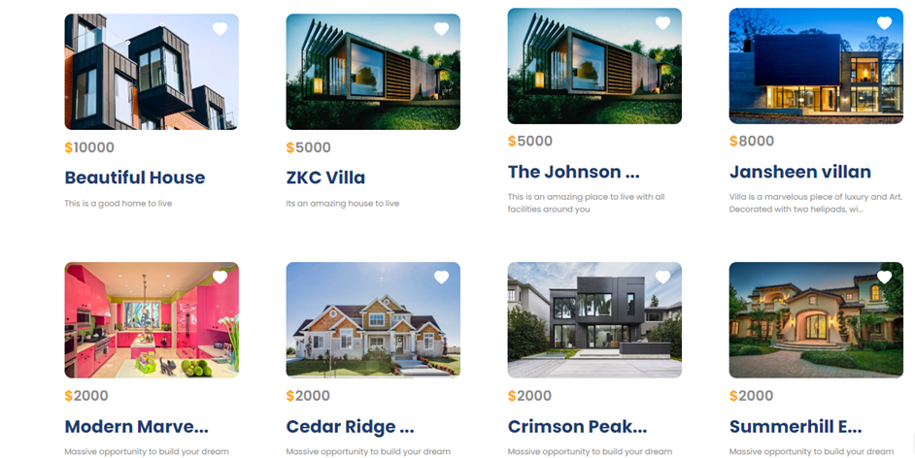
Property Listing Page

Slide 12
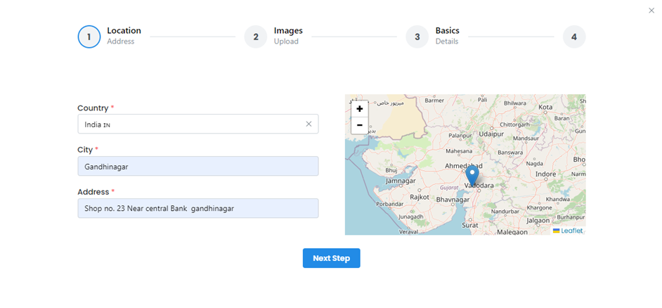
Adding new property

Slide 13
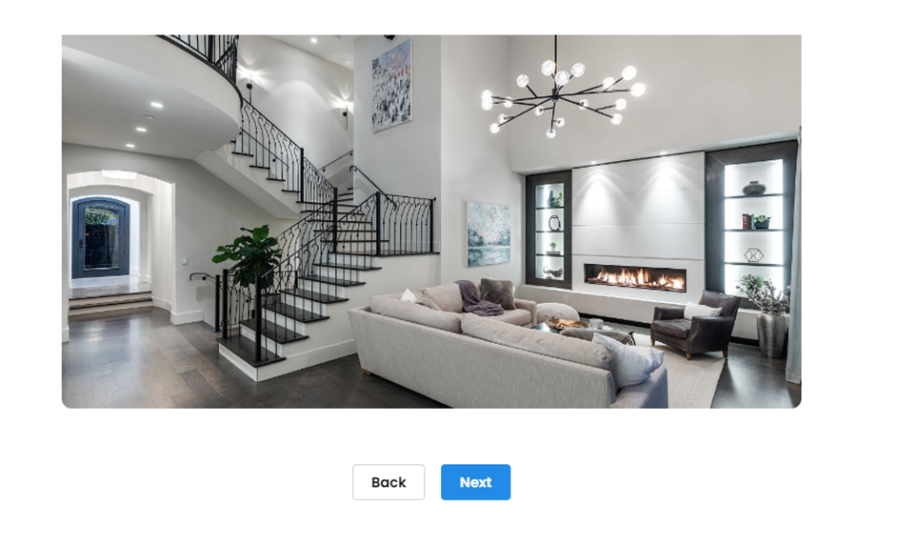

Adding new property

Slide 14
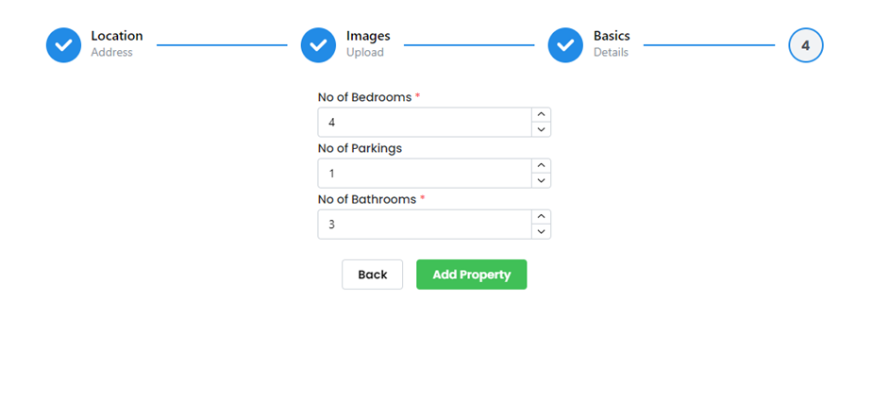
Adding new property

Slide 15
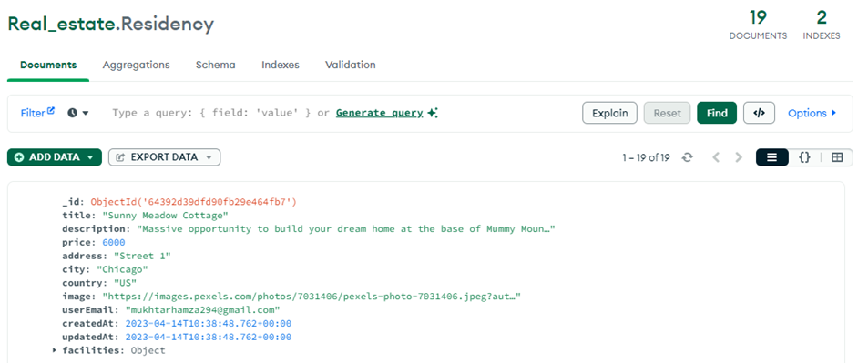
Residency Database

Slide 16
THANK YOU

